Slide 1
English

Slide 2
AP Language & Composition

Slide 3
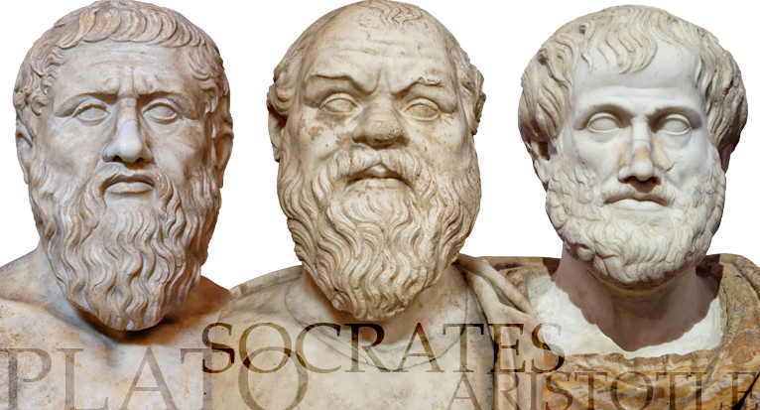
What is AP Language & Composition?
Recommended for Sophomores, Juniors and Seniors
Higher Level English course allowing college credit in a seminar style class
Focuses intensively on analysis and discussion of Education, Community, Language, Gender, and historically great speeches.
Practices group discussion and intellectual exchange
Exposure to Greek and Latin roots building vocabulary strength
Frequent practice responding to Synthesis, Rhetorical Analysis, & FRQs

Slide 4
How does this class help students?
Learn to analyze speech and writing to gain strength in reading & listening.
Step-by-step guidance in argumentative research writing using MLA
Curriculum promotes developing presentations, speaking, and writing skills
Read predominantly shorter pieces of non-fiction
Develop critical thinking and analytical skills necessary for success in higher level courses in high school and college
Prepare successfully for the AP test in May

Slide 5
More information:
see Ms. Brubaker at Portable 15 or email her at brubakerm@pscb.org
If you are interested, please sign up for Advanced Placement Language & Composition

Slide 9
ENC 1101 (Comp 1)
Rhetorical Analysis ¶ Argumentation ¶ Research and Synthesis

Slide 10
English…
“I genuinely feel like this class has made me a better person.”
--former Comp 1 student
…is at the center of all learning for all courses. English classes attend to reading, writing, thinking, speaking, logic and organization, as well as meaning making.

Slide 11
“[Comp 1] has really made me enjoy the art of writing and taking a deeper look into why writers really write.”
--former Comp 1 student

Slide 12
Dual Enrollment Composition I
College Credit
Emphasis on Process
Focus on Note- taking
Discussion based lecture
Connect to all fields of study
Students who do all assignments in good faith are guaranteed a C, most make an A or a B
Learning to analyze and developing a sensitivity to the language are emphasized over grades
Note-taking is a form of participation; this skill will be developed
What students bring to the discussion is important and you will be encouraged to use your voice
English is at the center of all fields of study—this course will aid in processing information and meaning making

Slide 13
“The reason I really enjoy AVID is because I can learn how to be organized and it helps me to keep up with my classes. AVID is an essential course for learning about colleges as well as how to be more effective in school.”
- Alexander Lambridis
“I like AVID because the teachers are always wanting to know if your doing good in your classes and they’re very nice to each kid. I like to be in AVID because it keeps me on track.”
- Victor Santos

